Slide 1
Literature review so far
Early studies:
Focused on short, trimmed clips in constrained environments
(e.g. Hockey Fight, Movie Fight datasets).
Modalities used
Mostly visual-only approaches with limited use of audio or other cues.
Feature engineering
Relied heavily on hand-crafted features (e.g. optical flow, motion vectors) instead of deep learning.
Limitations Identified
Lack of real-world complexity (e.g. crowd density, occlusion)
Poor generalisation to untrimmed, noisy surveillance videos
Few models trained with weak supervision
Limited multimodal integration (vision + audio)
Recent Advances (e.g. XD-Violence, ECCV 2020):
Use of multimodal data (video + audio)
Training with weak labels over untrimmed video
Focus on online detection, not just classification

Slide 2
Dataset used: XD-violence dataset
Released by researchers from Xidian University
Introduced in ECCV 2020 (Poster Presentation)
Contains 4754 untrimmed videos, totalling 217 hours
* But only 3,703 videos(2,903 training, 800 testing) accessible
Includes both video and audio modalities
Uses weak labels (violence tagged at video-level, not frame-level)
Designed for multi-scene, real-world surveillance settings
Enables multimodal learning and online (real-time) detection research
Addresses limitations of earlier datasets (short clips, single modality)

Slide 3
Modular neural network architecture
Past researches mainly focus on action recognition using CNN+LSTM or 3D CNNs
However, many violent events involve multiple features, such as:
Presence of weapons (e.g. knife, gun)
Sudden explosions or screams
Crowd panic or fleeing behaviour
Studies like [XD-Violence, 2020] and [UCF-Crime, 2018] attempt end-to-end classification
→ but lack fine-grained interpretability or early warning.
Inspired by modular deep learning and multimodal learning, this design splits the problem:
Detecting visual threats (weapon)
Recognising acoustic signals (explosions, screams)
Tracking crowd behaviour (panic)
Recognising aggressive actions (punching, kicking)
This enables:
Better interpretability
Potential for early warning
Scalability across domains (e.g., schools, stations)

Slide 4
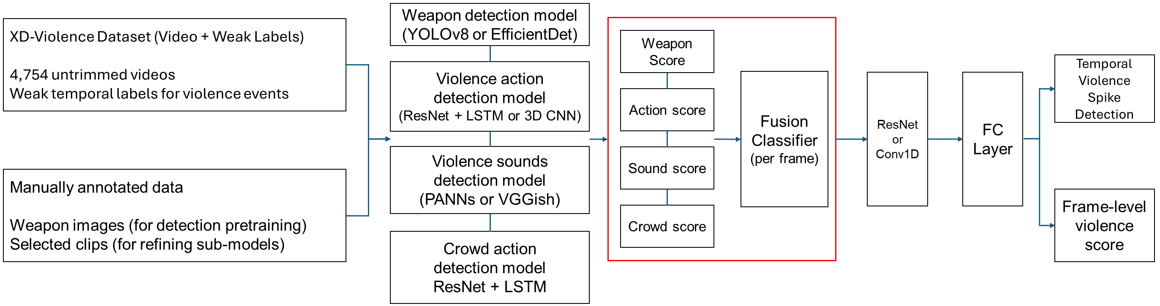
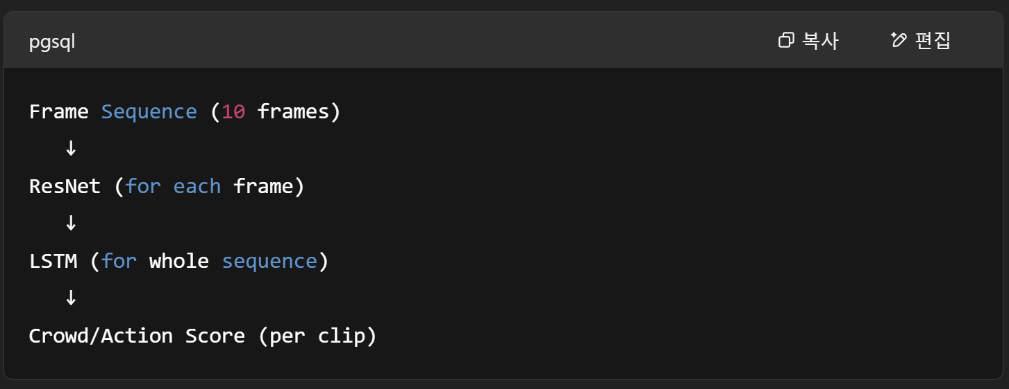

Slide 6
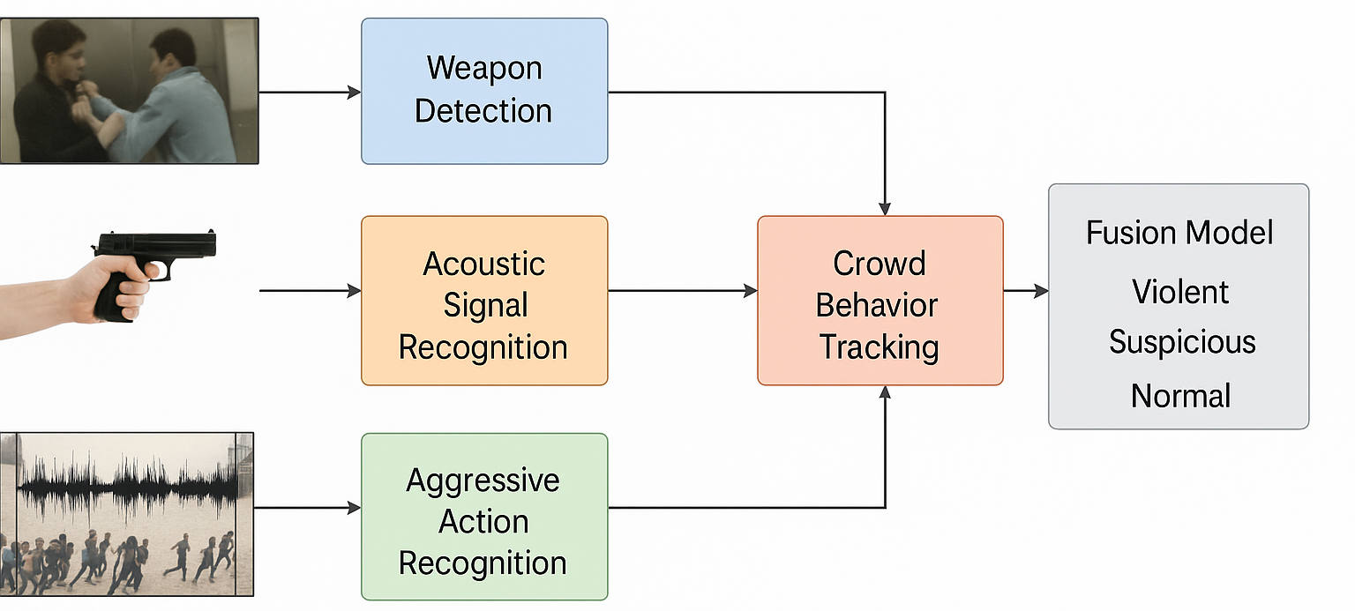

Slide 7
Weapon detection model
(YOLOv8 or EfficientDet)
XD-Violence Dataset (Video + Weak Labels)
4,754 untrimmed videos
Weak temporal labels for violence events
Weapon Score
Violence action
detection model
(ResNet + LSTM or 3D CNN)
Temporal Violence Spike Detection
Fusion
Classifier
(per frame)
ResNet
or
Conv1D
FC
Layer
Action score
Violence sounds
detection model
(PANNs or VGGish)
Sound score
Manually annotated data
Weapon images (for detection pretraining)
Selected clips (for refining sub-models)
Frame-level violence score
Crowd score
Crowd action
detection model
ResNet + LSTM
Notes:
Instead of relying on a single end-to-end model, I propose a hybrid modular architecture where different sub-models detect key violence indicators
weapons, aggressive actions, and violent audio events. These are fused into a frame-wise violence signal.
The final classification is made via ResNet layers followed by a fully connected layer.”

